Slide 1
Introduction to Statistical Methods
ISM TEAM

Slide 2
Session No 12
(19th /20th Feb ,2021)
Regression

Slide 3
Contact Session 12: Module 5 – Regression
Contact Session | List of Topic Title | Reference
CS - 12 | Simple Linear regression model, Assumption of the model, interpretation of the model | T1:Chapter 12 & 13
HW | Problems on Linear regression | T1:Chapter 12 & 13
Lab

Slide 4
Session 12 - Agenda
Simple Linear regression model,
Assumption of the model,
interpretation of the model
Multiple linear regression model
non – linear regression
Logistic regression
( Introducing the model as a continuation of regression models)

Slide 5
Regression

Slide 9
CORRELATION | REGRESSION
Measuring strength or degree of the relationship between two variables | Having an algebraic equation between two variables
No estimation | Estimation
Both variables are independent | One is dependent variable and the other is independent variable

Slide 23
Assumptions of the Linear Regression
Assumptions about the Error
E(ε_{i} ) = 0 for i = 1, 2,…,n.
σ(ε_{i} ) = σ_{ε} where σ_{ε} is unknown.
The errors are independent, that is, the error in the ith observation is independent of the error observed in the jth observation.
The ε_{i} are normally distributed (with mean 0 and standard deviation σ_{ε}).

Slide 24

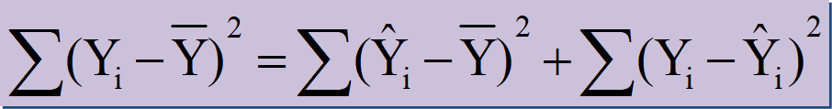
Coefficient of Determination
where:
SST = Sum of Squares due to Total
SSR = Sum of Squares due to Regression
SSE = Sum of Squares due to Error

Slide 25
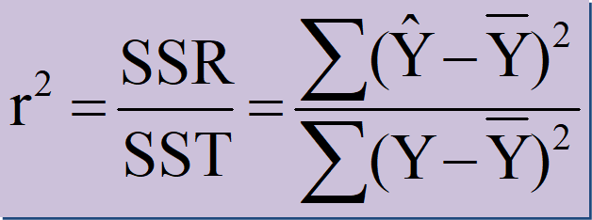
where:
SST = Sum of Squares due to Total
SSR = Sum of Squares due to Regression

Slide 26
Moving from SLR to MLR
The new aspects to consider when moving from simple to multiple linear regression are:
Overfitting
As you keep adding the variables, the model may become far too complex
It may end up memorising the training data and will fail to generalise
A model is generally said to overfit when the training accuracy is high while the test accuracy is very low
Multicollinearity
Associations between predictor variables, which you will study later
Feature selection
Selecting the optimal set from a pool of given features, many of which might be redundant becomes an important task

Slide 27
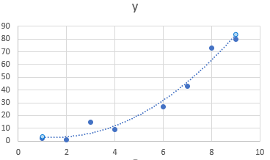
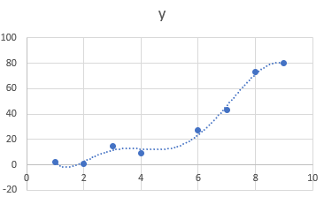
Overfitting
Which of these two models would be a better fit to the data?

Slide 28
Multicollinearity
It refers to the phenomenon of having related predictor variables in the input dataset.
In simple terms, in a model which has been built using several independent variables, some of these variables might be interrelated, due to which the presence of that variable in the model is redundant. You drop some of these related independent variables as a way of dealing with multicollinearity.
Multicollinearity affects:
Interpretation:
Does “change in Y, when all others are held constant” apply?
Inference:
Coefficients swing wildly, signs can invert
p-values are, therefore, not reliable

Slide 29
Dealing with Multicollinearity
Two basic ways of dealing with multicollinearity
Looking at pairwise correlations
Looking at the correlation between different pairs of independent variables
Checking the Variance Inflation Factor (VIF)
Sometimes pairwise correlations aren't enough
Instead of just one variable, the independent variable might depend upon a combination of other variables
VIF calculates how well one independent variable is explained by all the other independent variables combined

Slide 30
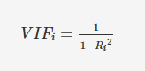
Variance Inflation Factor (VIF)
The VIF is given by:
where 'i' refers to the i-th variable which is being represented as a linear combination of rest of the independent variables.
The common heuristic we follow for the VIF values is:
> 10: Definitely high VIF value and the variable should be eliminated.
> 5: Can be okay, but it is worth inspecting.
< 5: Good VIF value. No need to eliminate this variable.

Slide 32
Multiple Linear Regression

Slide 39
How to model
Sales and advertisement on TV, News Paper ,Radio
Few Guidelines
- keep the variables with low p – values and eliminate the ones
with high p – values
- inclusion of a variable to the model should ideally increase
the value of R – Squared

Slide 40
an idea
Forward Selection
Backward selection

Slide 41
Name | Definition | R^2/Adj R^2 | F-Statistic | P – value | RSE
Model 1 | Sales – TV | 0.612/0.610 | 312.1 | 1.47exp(-42) | 3.25(23%)
Model 2 | Sales – TV + News Paper | 0.646/0.642 | 179.6 | 3.95exp(-42) | 3.12(22%)
Model 3 | Sales – TV+ Radio | 0.897/0.896 | 859.6 | 4.83exp(-42) | 1.71(12%)
Model 4 | Sales – TV+ Radio + News Paper | 0.897/0.896 | 570.3 | 1.58exp(-42) | 1.80(13%)

Slide 47
Accurac of a model
By Using the following the strength of the linear model can be tested
Coefficient of determination
Residual Standard error

Slide 51
R – Squared vs Adjusted R - Squared
In multiple regression, adjusted R – squared is better metric than R – squared asses the goodness of fit of the model
R – squared always increases if additional variables are added into model , even if they are not related to the dependent variable

Slide 52
Accessing the model fit
After you have determined that the coefficient is significant, using p-values, you need some other metrics to determine whether the overall model fit is significant. To do that, you need to look at a parameter called the F-statistic. So,the parameters to assess a model are:
t statistic: Used to determine the p-value and hence, helps in determining whether the coefficient is significant or not
F statistic: Used to assess whether the overall model fit is significant or not. Generally, the higher the value of F statistic, the more significant a model turns out to be
R-squared: After it has been concluded that the model fit is significant, the R-squared value tells the extent of the fit, i.e. how well the straight line describes the variance in the data. Its value ranges from 0 to 1, with the value 1 being the best fit and the value 0 showcasing the worst.

Slide 53
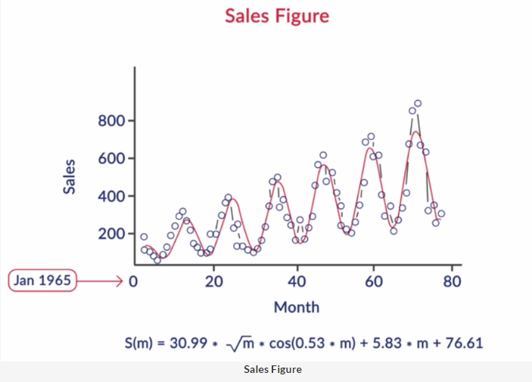
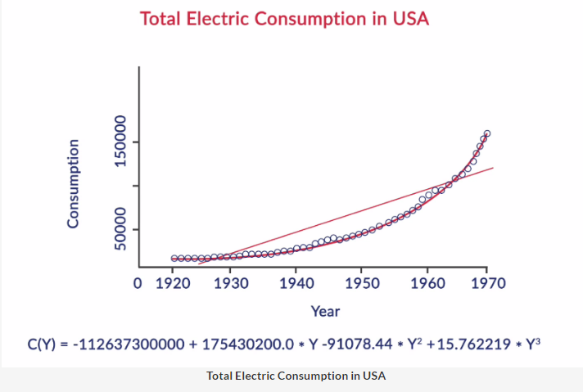
Non-linear Regression
In the first example, notice that the data points oscillate and follow a sine or cosine type of function.
In the second example of electricity consumption, the data points gradually increase non-linearly, indicative of a polynomial or an exponential function:

Slide 54
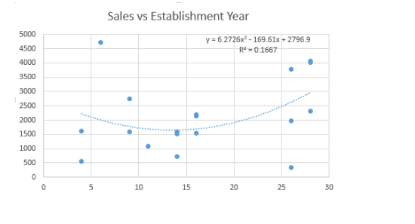
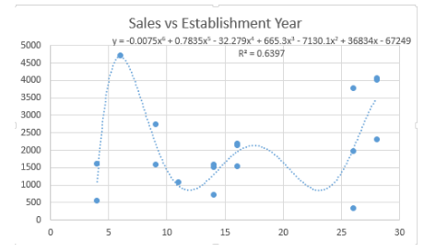
Non-linear Regression
Polynomial regression is another form of regression in which the maximum power of the independent variable is more than one.
In this regression technique, the best fit line is not a straight line instead it is in the form of a curve.

Slide 55
Regularization
Over fitting can be solved with regularization
Regularization can be done by putting constraints on the coefficients and variables.
LASSO: Least Absolute Shrinkage and Selection Operator
Some coefficients can be dropped( i.e become zero)
RIDGE: The coefficients will approach zero, but never dropped

Slide 56
Lasso & Ridge
OLS estimation:
LASSO estimation:
Ridge regression estimation:

Slide 57
Logistic Regression

Slide 59
Logistic Regression
Logistic regression is a supervised classification model.
This allows us to make predictions from labelled data ,if the target variable is categorical.
Binary classification
Examples
A customer will default on a loan or not
A particular machine will break down in the next month or not
Predicting whether an incoming email is spam or not

Slide 65
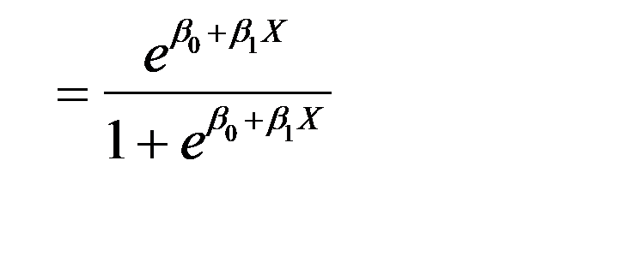
Binary Logistic Regression Model
Y = Binary response
X = Quantitative predictor
p = proportion of 1’s (yes, success) at any X
Equivalent forms of the logistic regression model:
Logit form
Probability form

Slide 66
Binary Logistic Regression Model
Y = Binary response
X₁,X₂,…,X_{k} = Multiple predictors
X = Single predictor
π = proportion of 1’s (yes, success) at any x
π = proportion of 1’s at any x₁, x₂, …, x_{k}
Equivalent forms of the logistic regression model:
Logit form
Probability form

Slide 67
Thanks

